Slide 1
Relational extensions for GUHA procedures
Alexander Kuzmin
07.06.2007

Slide 2
Task
Implementation of relational extensions for 4FT and SD4FT

Slide 3
Relational datamining
Virtual attributes
  New columns virtually added to the main data matrix
Aggregation virtual attribute
(TYPE=„DEPOSIT“)&(AVGAMOUNT>5000) → _{0,8;20} OPERATION=„TRANSFERTOACCOUNT“
AVGAMOUNT = AVG(amount)

Slide 4
Relational datamining
Hypotheses attribute
(HIGHPAYMENTS) & (SALARY>15000) & (DISTRICT =„Praha“) → _{0,8;10} LOANSTATUS =„Good“
HIGHPAYMENTS :
TYPE =„PAYMENT“→ _{0,9;10} AMOUNT > 5000

Slide 5
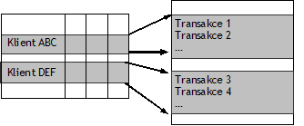
Hypotheses attribute - 1/2
Task basics
  Virtual attribute values are results of the DM task on the detail data matrix
  Subtask runs on subset of the rows of the detail data matrix

Slide 6
Hypotheses attribute - 2/2
Subtask returns Boolean vectors with the size equal to main data matrix row count
Each vector represents one relevant question of the subtask
Values of the vector represent the validity of the relevant question on the subset of rows of the detail data matrix
Subset is given by the relation to the object in the main data matrix

Slide 7
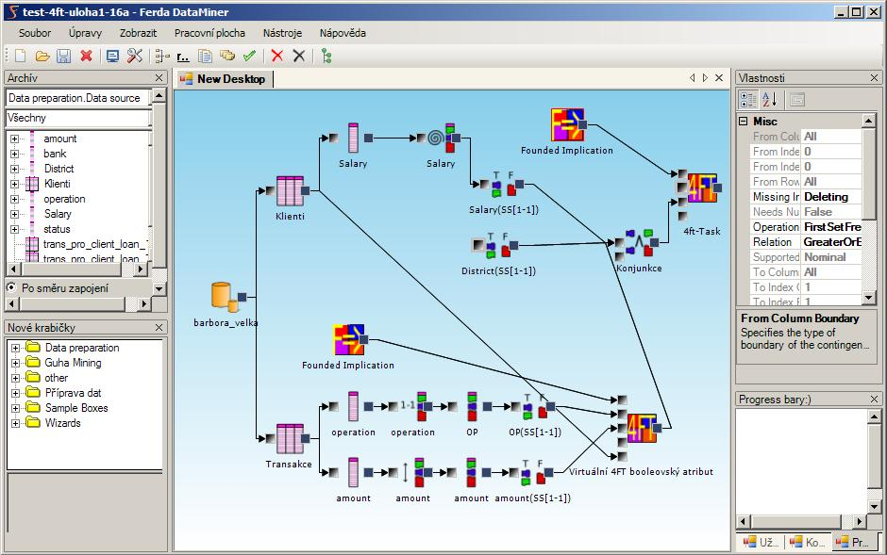
Task example

Slide 8
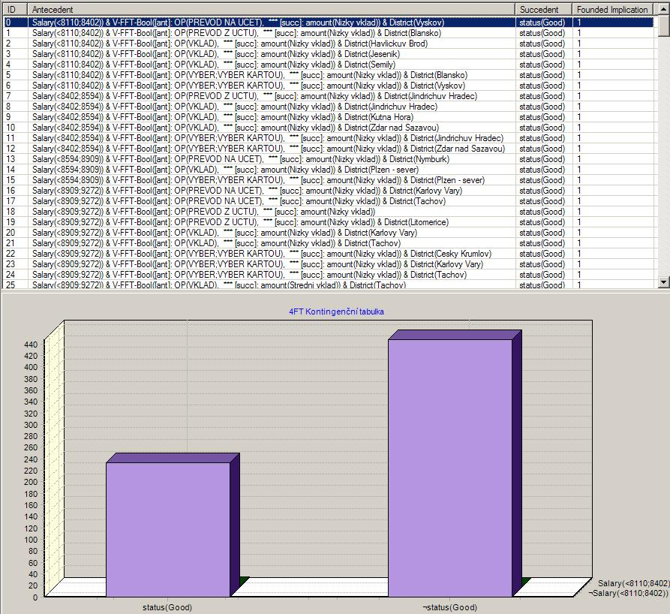
Results – 1/2

Slide 9
Results – 2/2
Hypothesis 0:
Antecedent:
  Salary (<8110;8402)) &
  V-FFT-Bool([ant]: OP(PREVOD NA UCET), *** [succ]: amount(Nizky vklad)) &
  District(Vyskov)
Succedent: status(Good)
Virtual attribute V-FFT-Bool
  Antecedent: OP(PREVOD NA UCET)
  Succedent: amount(Nizky vklad)

Slide 10
Relational datamining
„Hypotheses space explosion“
Difficult results interpretation

Slide 11
Implementation
Ferda DataMiner framework
MS .NET and C#
GPL

Slide 12
Implementation
Utilization of existing elements of the framework
  Task philosophy
  Framework
Adaptation of the framework for relational datamining

Slide 13
Implementation
How to run the subtask:
  Count virtual attributes values in advance
  Count virtual attributes values step by step

Slide 14
Implementation details
Modification of the existing procedures for subtask using yield in C# 2.0
Using masks for counting bitstrings for row subsets of the detail data table

Slide 15
Future perspectives
More testing on relevant data
Relational extensions for the rest of the procedures in Ferda
Better result viewing
Recursive virtual attributes
Virtual columns containing real numbers (fuzzy bitstrings)

